Slide 1

Web scraping to gain company insights
26/06/2024

Slide 2
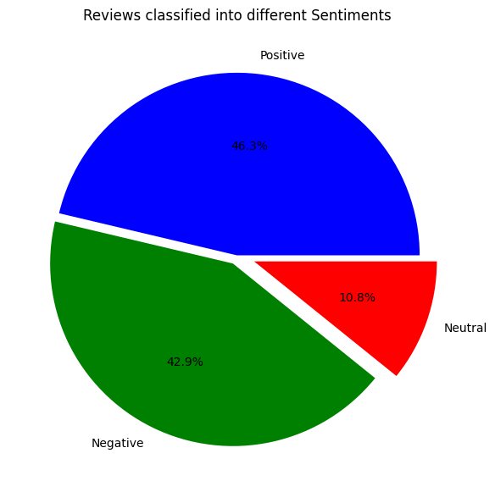
INSIGHTS FROM CUSTOMER REVIEWS
From cleaning 1000 reviews given by the customers, we obtained
Positive Reviews - 463
Negative Reviews - 429
Neutral Reviews – 108

Slide 3
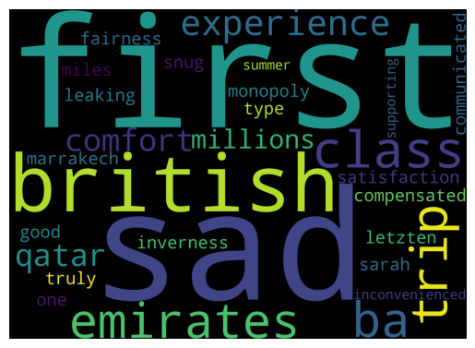
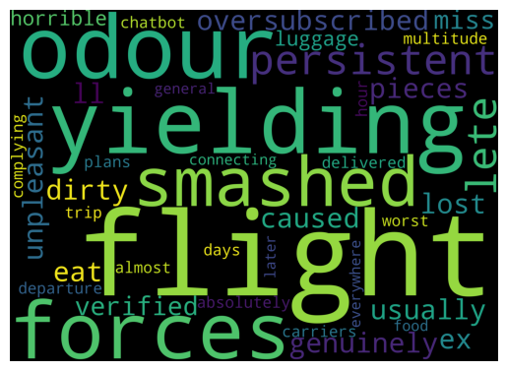
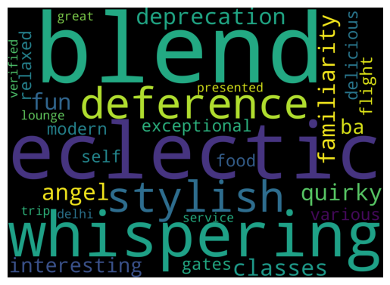
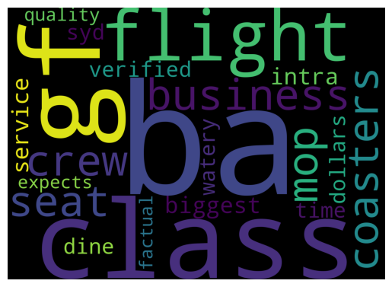
Wordclouds for keywords used in 4 topics

